Slide 1

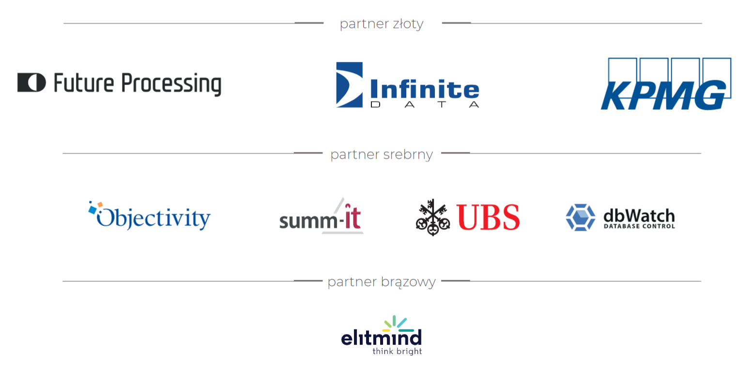

Slide 2

AZURE DATA LAKEHOUSE JUŻ ROK NA PRODUKCJI
Tomasz Krawczyk

Slide 3
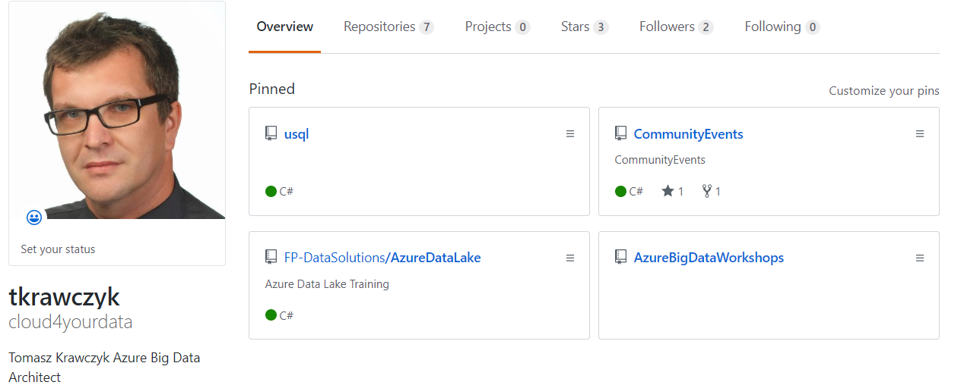



ABOUT ME
https://github.com/cloud4yourdata/SQLDay2022
https://github.com/cloud4yourdata/
https://github.com/FP-DataSolutions/

Slide 4

AGENDA
Data lakehouse
Concept and architecture
Azure Data lakehouse – Challenges
Model materialization
Synapse CETAS, Custom Solution, Delta Live Tables
Processing optimization
Maintenance
Serving Layer – Databricks SQL Endpoints
Demo(s)
Q&A

Slide 5
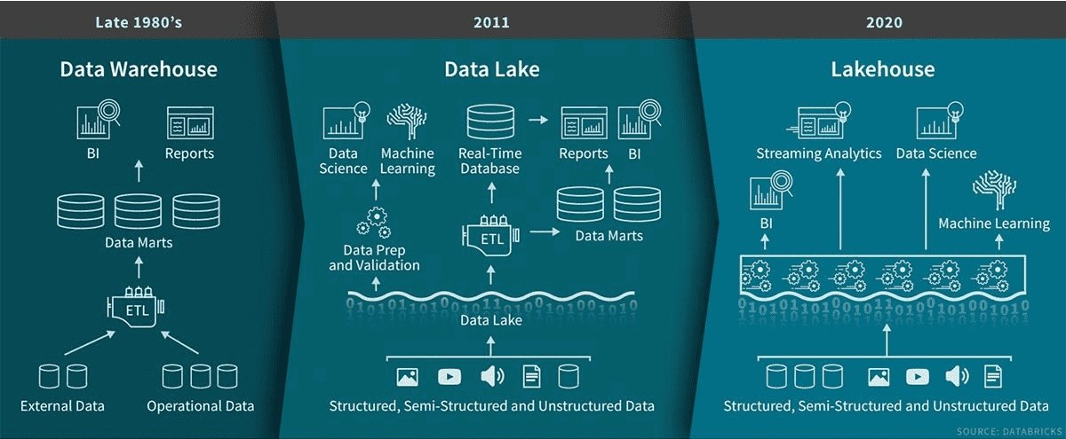
WHAT IS A DATA LAKEHOUSE ?
Source: Databricks

Slide 6
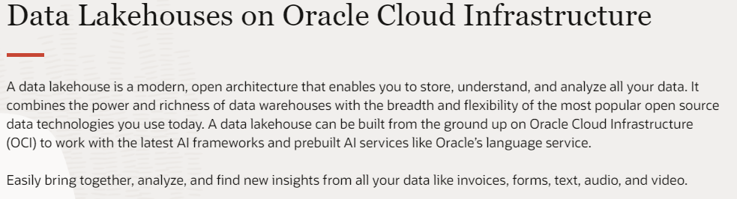

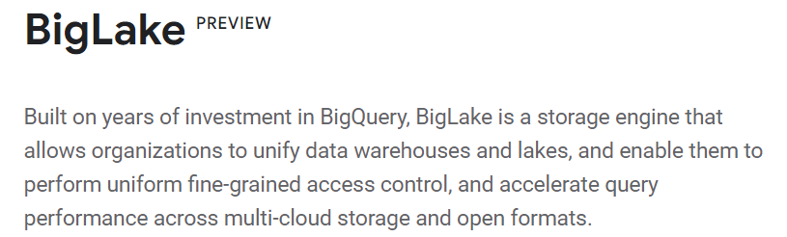
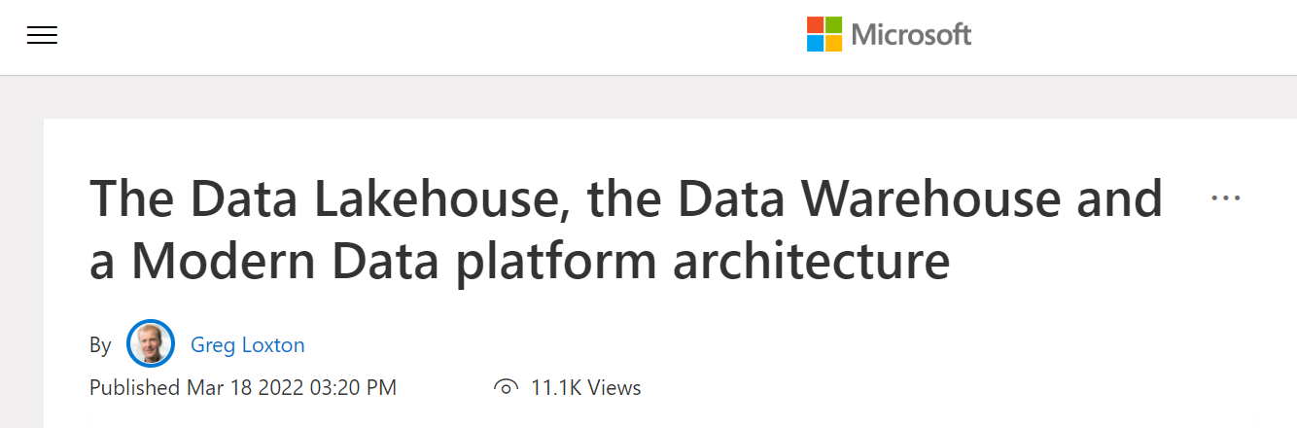

WHAT IS A DATA LAKEHOUSE ?

Slide 7
 | Data Warehouse | Data Lake | Data Lakehouse
Data format | Closed, proprietary format | Open format | Open format
Types of data | Structured data, with limited support for semi structured data | All types: Structured data, semi-structured data, textual data, unstructured, (raw) data | All types: Structured data, semi-structured data, textual data, unstructured (raw) data
Data access | SQL-only | Open APIs for direct access to files with SQL, R, Python, and other languages | Open APIs for direct access to files with SQL, R, Python, and other languages
Reliability | High quality, reliable data with ACID transactions | Low quality, data swamp | High quality, reliable data with ACID transactions
Performance | High | Low** | High**
Scalability | Scaling becomes exponentially more expensive* | Scales to hold any amount of data at low cost, regardless of type ** | Scales to hold any amount of data at low cost, regardless of type **
Use cases | Limited to BI, SQL applications, and decision support | Limited to machine learning * | One data architecture for BI, SQL, and machine learning (and streaming)

Slide 8
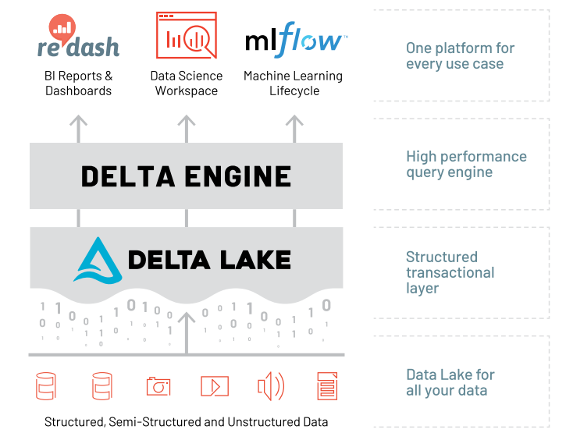
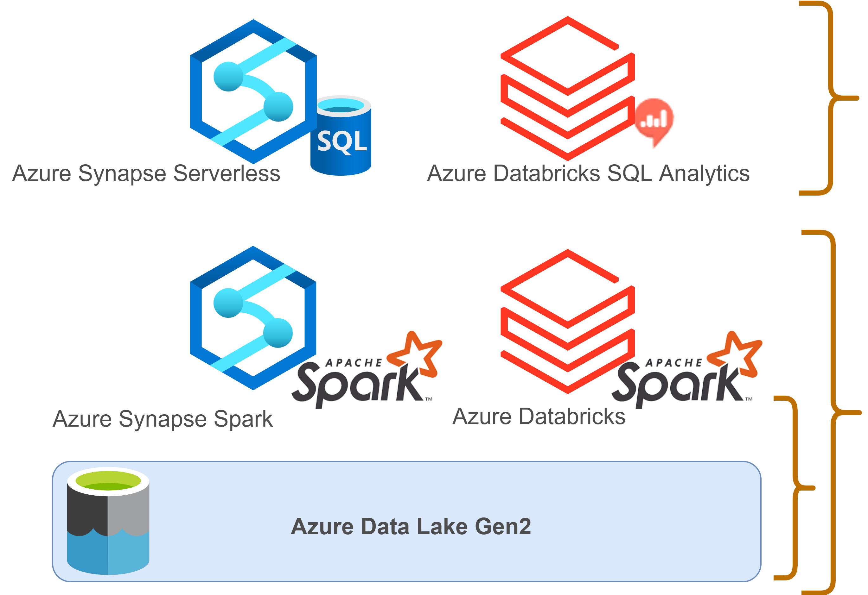
AZURE DATA LAKEHOUSE

Slide 9
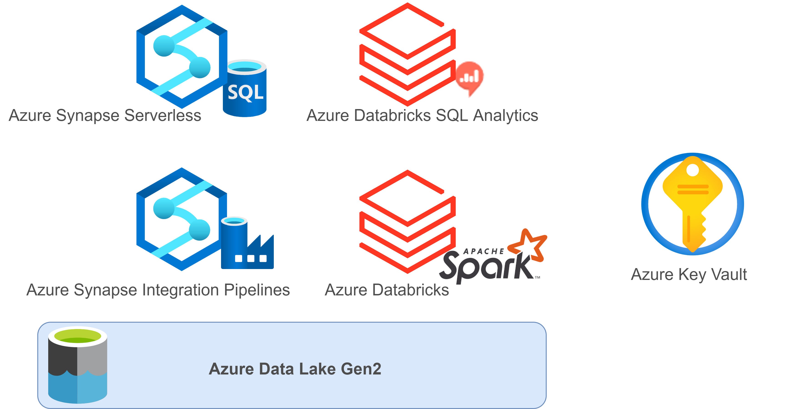
AZURE DATA LAKEHOUSE

Slide 10
DATA LAKEHOUSE - DATA FLOW
Source System(s)
Relational databases
Flat files (CSV)
API (REST)
Landing Zone (Bronze)
EL Processes:
Metadata framework
Azure Data Factory
Azure Synapse Integration Pipelines
Data structure
Folders
Data partitioning
By load date
Data Format
Parquet (**)
Native (Json, Avro, Csv)
Curated Zone (Silver)
ETL Processes:
Metadata framework
Spark (Databricks)
Transformations
Slowly Changing Dimensions Type 2
Data Format
Delta
Spark Tables (one to one : source -> curated zone)
Serving data
Azure Synapse Serverless
Views on Delta Tables
Azure Databricks SQL Analytics
Serve Zone (Gold)
ETL Processes:
Metadata framework
Spark (Databricks)
Transformations
Data Model (Kimball)
Data Format
Delta
Spark Tables
Model
Model based on views
Materialized tables
Serving data
Azure Synapse Serverless
Views on Delta Tables
Azure Databricks SQL Analytics

Slide 11

DATA LAKEHOUSE – VIRTUAL MODEL
Virtual Model = Views on Azure Synapse Serverless
Azure Synapse Serverless
Support for Delta Format
Parquet + manifest files
Problems with performance
Query Performance Insights
GitHub - JocaPC/qpi: Query Performance Insight - analyze performance of your SQL Server Database Engine

Slide 12
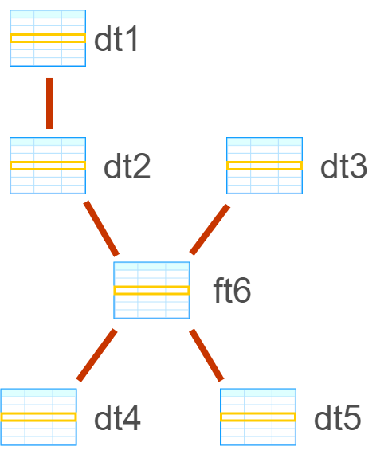
DATA LAKEHOUSE – MODEL MATERIALIZATION
Azure Synapse Serverless
CTAS – Create Table As Select
Limited
Azure Databricks
Custom solution
View -> Table (DDL)
View -> Merge->Table
Delta Live Tables
Now GA
Limited

Slide 13
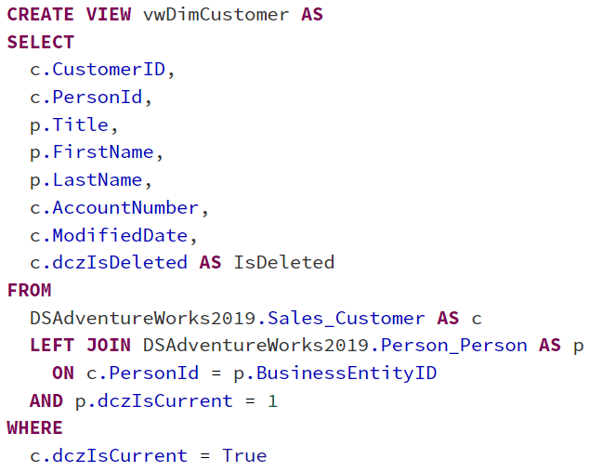
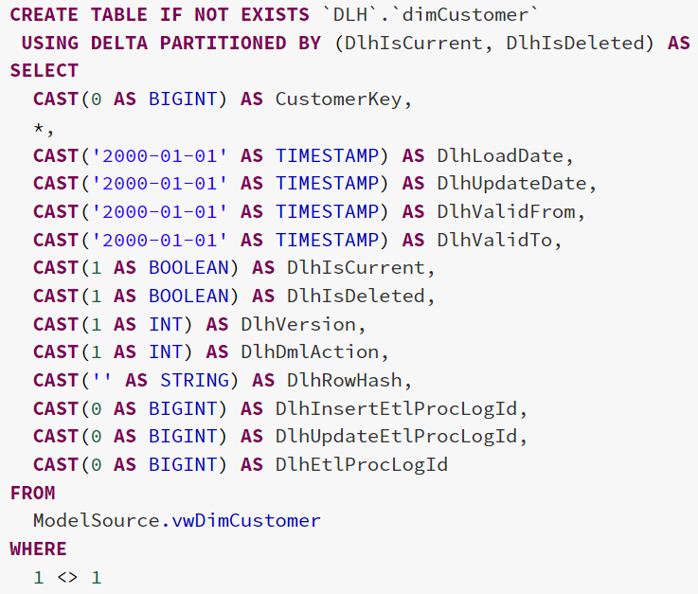
DLH- MODEL MATERIALIZATION – CUSTOM SOLUTION

Slide 14
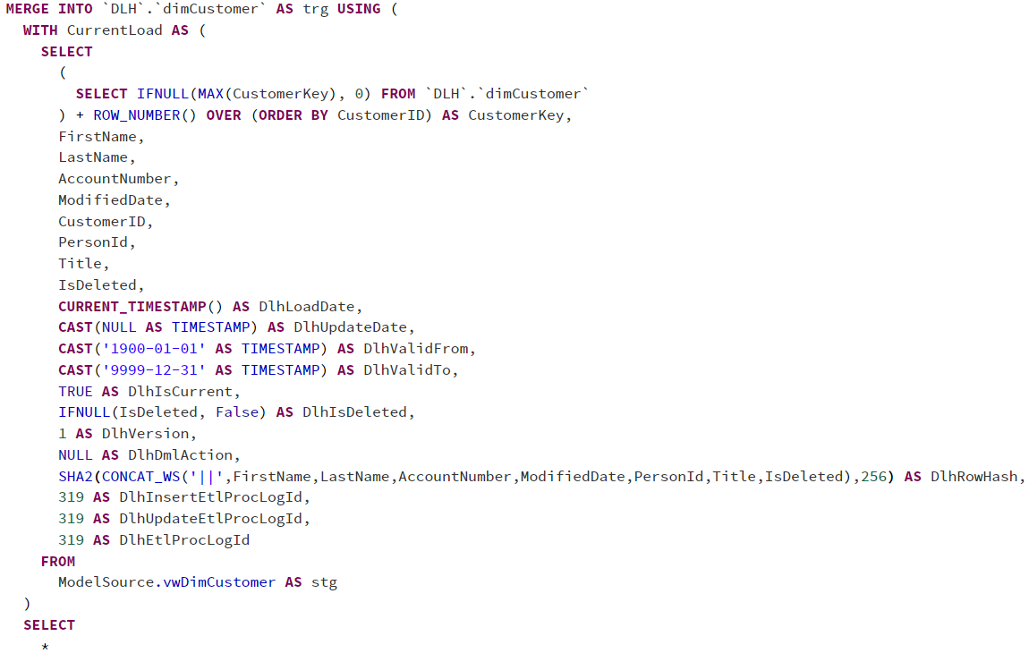
DLH - MODEL MATERIALIZATION – CUSTOM SOLUTION
Processing Type:
SCD Type 1
SCD Type 2
Truncate/Insert
Configuration:
Hash Columns
Source Primary Keys

Slide 15
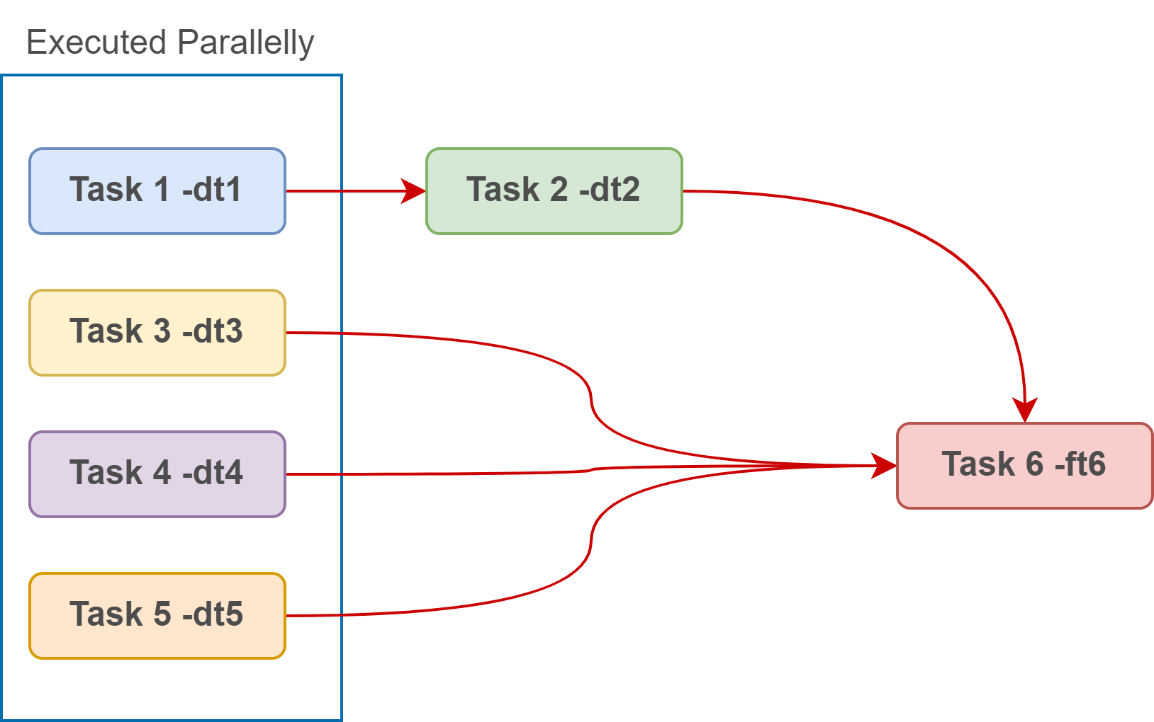
DLH - MODEL MATERIALIZATION – CUSTOM SOLUTION –DEPENDENCIES
Azure Databricks processing engine - Job Cluster
The Azure Databricks job scheduler creates a job cluster when you run a job on a new job cluster and terminates the cluster when the job is complete. You cannot restart a job cluster.

Slide 16

DATA LAKEHOUSE – SURROGATE KEYS
[Ralph Kimbal]
”Actually, a surrogate key in a data warehouse is more than just a substitute for a natural key. In a data warehouse, a surrogate key is a necessary generalization of the natural production key and is one of the basic elements of data warehouse design.”
Source: https://www.kimballgroup.com/1998/05/surrogate-keys/
Strategies:
monotonically_increasing_id
row_number() Rank OVER
ZipWithIndex()**
ZipWithUniqueIndex()**
Row Hash with hash()
Generated Columns - IDENTITY

Slide 17
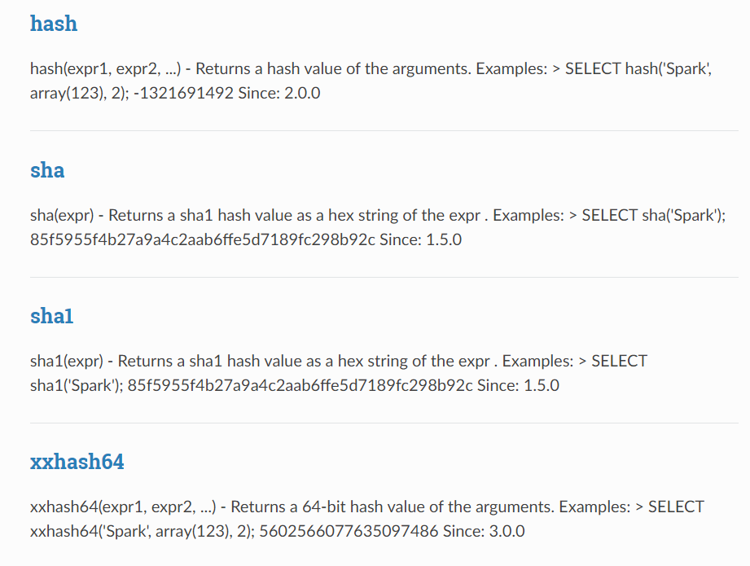
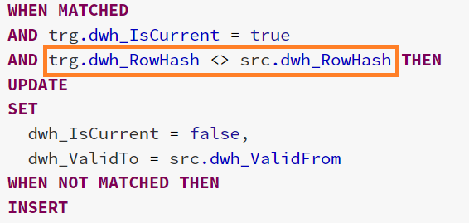
DATA LAKAHOUSE – HASH
“A hash function takes a group of characters (called a key) and maps it to a value of a certain length (called a hash value or hash)”
https://spark.apache.org/docs/latest/api/sql/search.html?q=hash

Slide 18
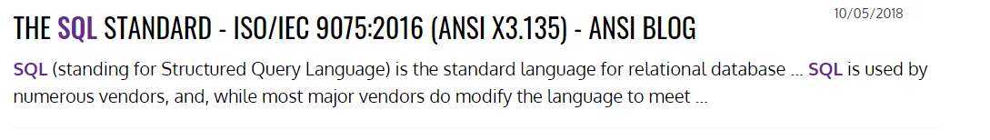

DATA LAKAHOUSE – SPARK ANSI COMPLIANCE
https://www.ansi.org/search#q=sql&sort=relevancy
Using RDD (Spark)
data = sc.textFile(...).split("\t")
data.map(lambda x: (x[0], [int(x[1]), 1])) \
.reduceByKey(lambda x, y: [x[0] + y[0], x[1] + y[1]]) \
.map(lambda x: [x[0], x[1][0] / x[1][1]]) \
.collect()
Using SQL (Spark)
SELECT name, avg(age)
FROM people GROUP BY name
When true, Spark attempts to conform to the ANSI SQL specification:
Throws a runtime exception if an overflow occurs in any operation on an integer or decimal field.
Forbids using the reserved keywords of ANSI SQL as identifiers in the SQL parser.

Slide 19
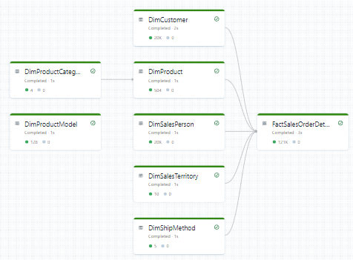
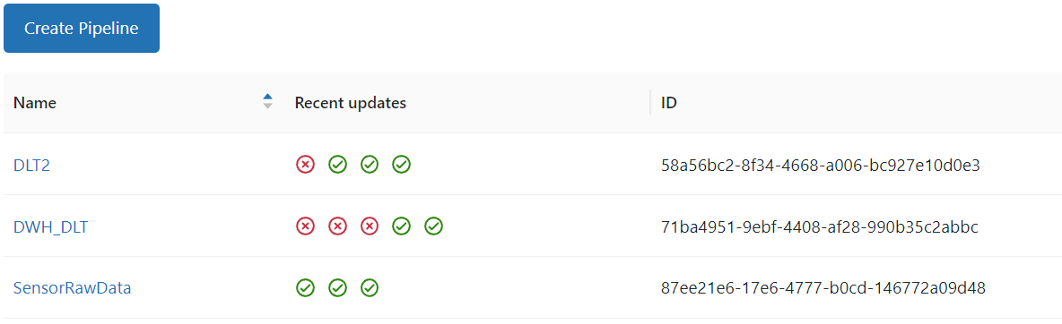
DATA LAKEHOUSE – DELTA LIVE TABLES
What is a Live Tables?
Live Tables are materialized views for the lakehouse.
Declarative ETL
A Live Table is:
Defined by a SQL query (or Python)
Created and kept up-to-date by a pipeline

Slide 20
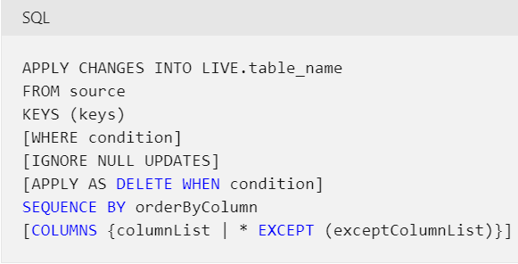
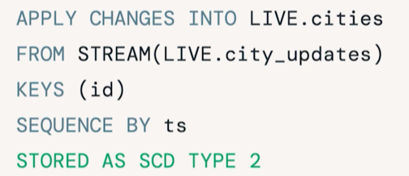
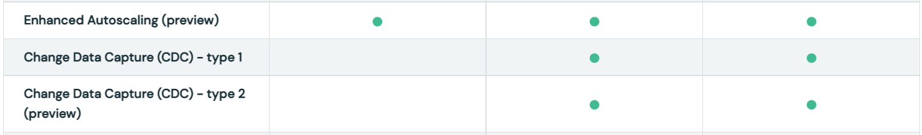
DATA LAKEHOUSE – DELTA LIVE TABLES
Change data capture with Delta Live Tables
MERGE = APPLY CHANGES
Slowly Changing Dimensions Type2
Roadmap
https://docs.microsoft.com/en-us/azure/databricks/data-engineering/delta-live-tables/delta-live-tables-cdc

Slide 21
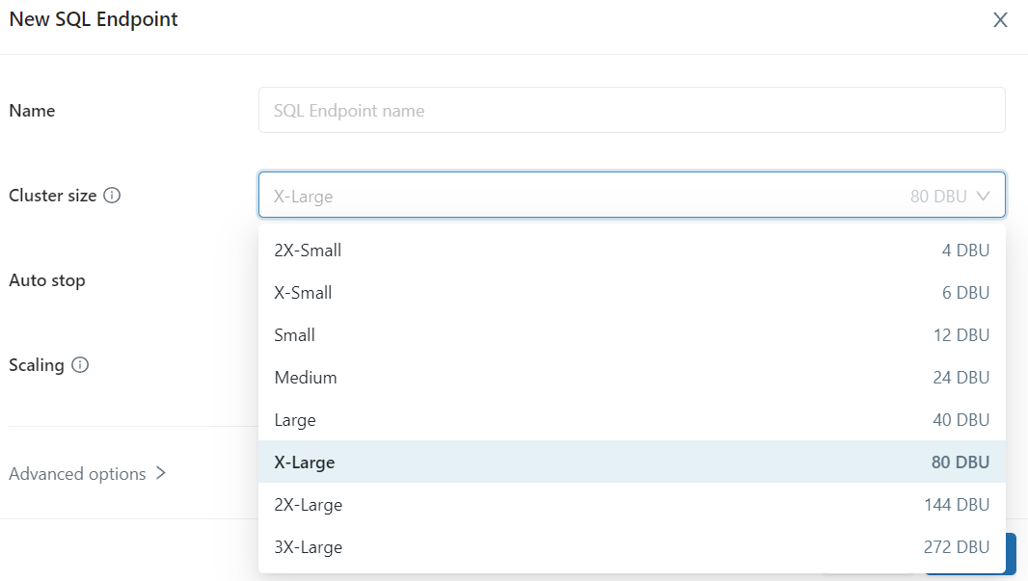
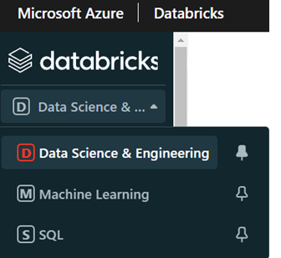
DATABRICKS SQL ANALYTICS
SQL Analytics allows customers to operate a multi-cloud lakehouse architecture
that provides data warehousing performance at data lake economics.
Source: https://databricks.com/product/sql-analytics

Slide 22
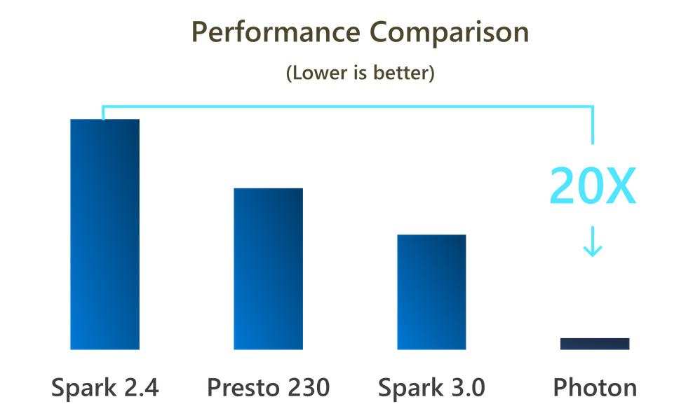
DATA LAKAHOUSE – PROCESSING OPTIMIZATION
PHOTON ENGINE
SPARK SETTINGS
DATA PARTITIONING
MERGE INTO
PARTITION PRUNNING
LOW SHUFFLE MERGE
OPTIMIZE
Z-ORDER
BLOOM INDEX
INSERT OVERWRITE instead of TRUNCATE /INSERT
SCHEMA EVOLUTION
CREATE OR REPLACE AS SELECT
https://techcommunity.microsoft.com/t5/analytics-on-azure-blog/turbocharge-azure-databricks-with-photon-powered-delta-engine/ba-p/1694929

Slide 23
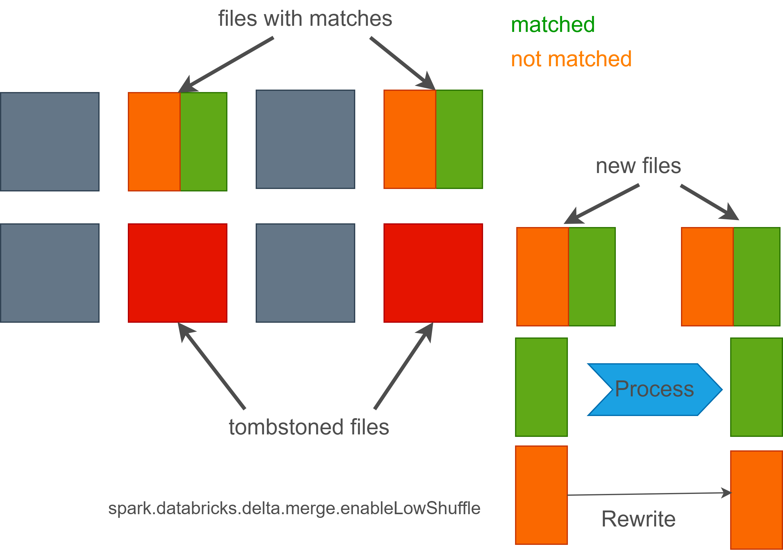
DATA LAKAHOUSE – MAINTENANCE
DELTA TIME TRAVEL
DESCRIBE HISTORY, RESTORE
OPTIMIZE
Z-ORDER
VACUUM
DLT –Auto
Auto Vacuum –on the roadmap
MERGE OPERATION

Slide 24
AZURE DATA LAKEHOUSE -SUMMARY
Azure Data Lakehouse
Azure Data Lake Gen2 + Azure Databricks + Azure Synapse
Databricks –Spark compute Engine + SQL Endpoints
Synapse –Integration pipelines + SQL Serverless
Materialized model vs virtual model
Custom solution (Spark)
Delta Live Table (?)
Generic Metadata Framework
Generic Metadata Framework – case study. How to use it in a project? | Blog Future Processing (future-processing.com)

Slide 25
DEMOS

Slide 26
Q & A
Contact:
tomasz.k.krawczyk@gmail.com
tkrawczyk@future-processing.com

Slide 27
RESOURCES
My examples (and demos)
https://github.com/cloud4yourdata/SQLDay2022
Blogs,pages,documentation, articles
https://docs.microsoft.com/en-us/azure/architecture/solution-ideas/articles/azure-databricks-modern-analytics-architecture
https://databricks.com/product/delta-live-tables
https://docs.microsoft.com/en-us/azure/databricks/release-notes/runtime/releases
https://docs.microsoft.com/en-us/azure/databricks/sql/user/security/access-control/sql-endpoint-acl
https://www.jamesserra.com/archive/2021/01/data-lakehouse-defined/
https://docs.microsoft.com/en-us/azure/databricks/delta/optimizations/auto-optimize
https://pivotalbi.com/local-databricks-development-on-windows/

